Slide 1
Online Retail Analysis
“By
Aman Gupta”
Here is where your presentation begins

Slide 2
Introduction
This Analysis focuses on online retail dataset to uncover patterns, identify opportunities, and drive data-driven decision-making. The dataset comprises sales transactions, customer information, and product details. Using visualizations and statistical analyses, we'll delve into aspects such as product sales, customer behavior, revenue distribution, and temporal patterns. Our aim is to extract actionable insights to foster business growth and enhance profitability.

Slide 3
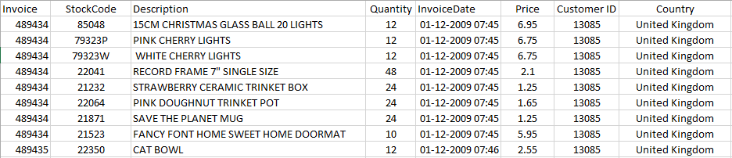
Structure of the Dataset

Slide 4
01
02
load DataSet
Data Exploration
OBJECTIVES
03
04
Data Cleaning
Data Analysis
Loading Dataset
& Importing Libraries
for analyzing
Overviewing Data, Checking Missing Values & Duplicates Entries
Cleaning and Preparing
Data
Analyzing the Data

Slide 5
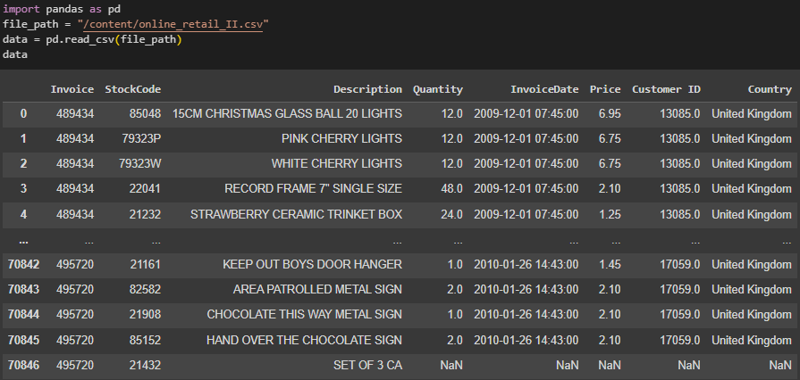
LOADING DATASET

Slide 6
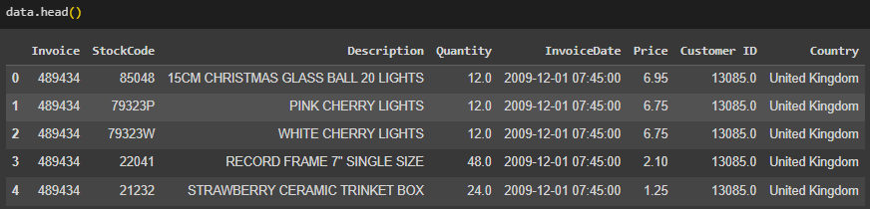
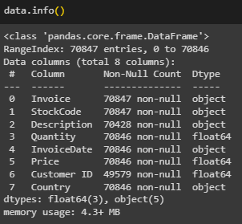
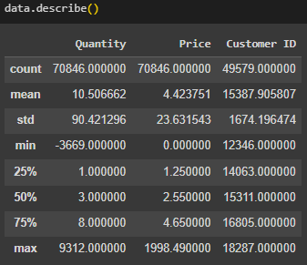
Data Exploration

Slide 7
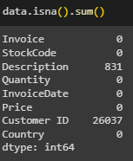
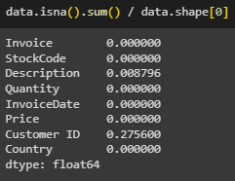
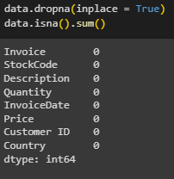
Data Cleaning & Handling Duplicates

Slide 8
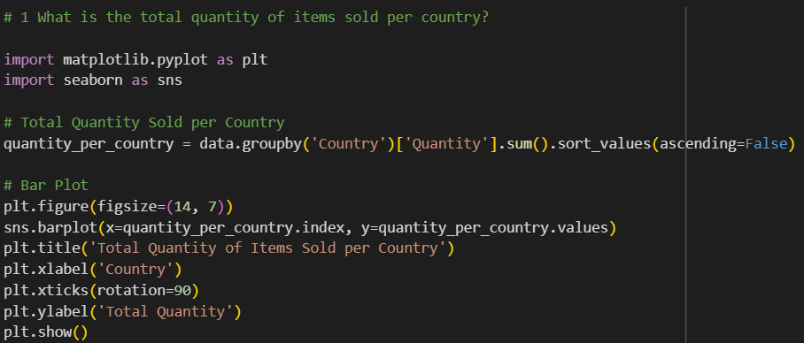
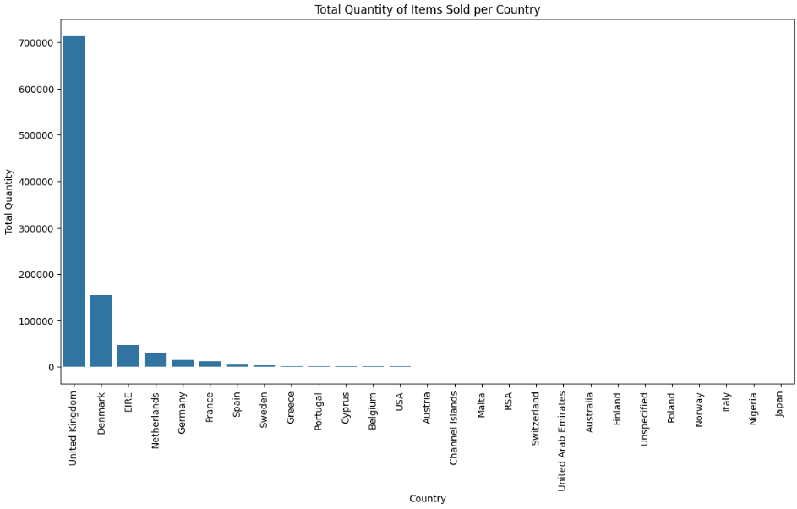
Data Analysis

Slide 9
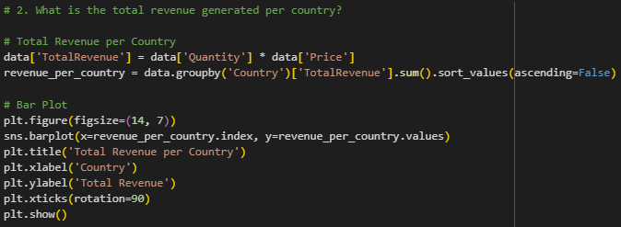
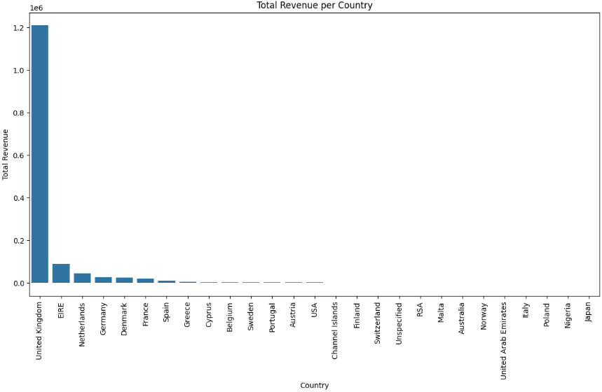
Data Analysis

Slide 10
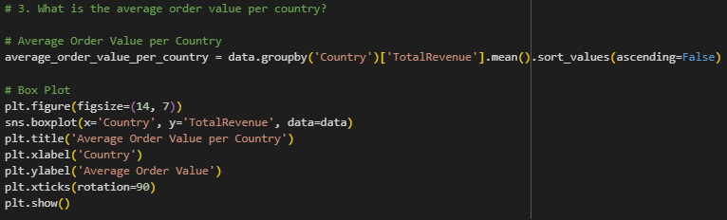
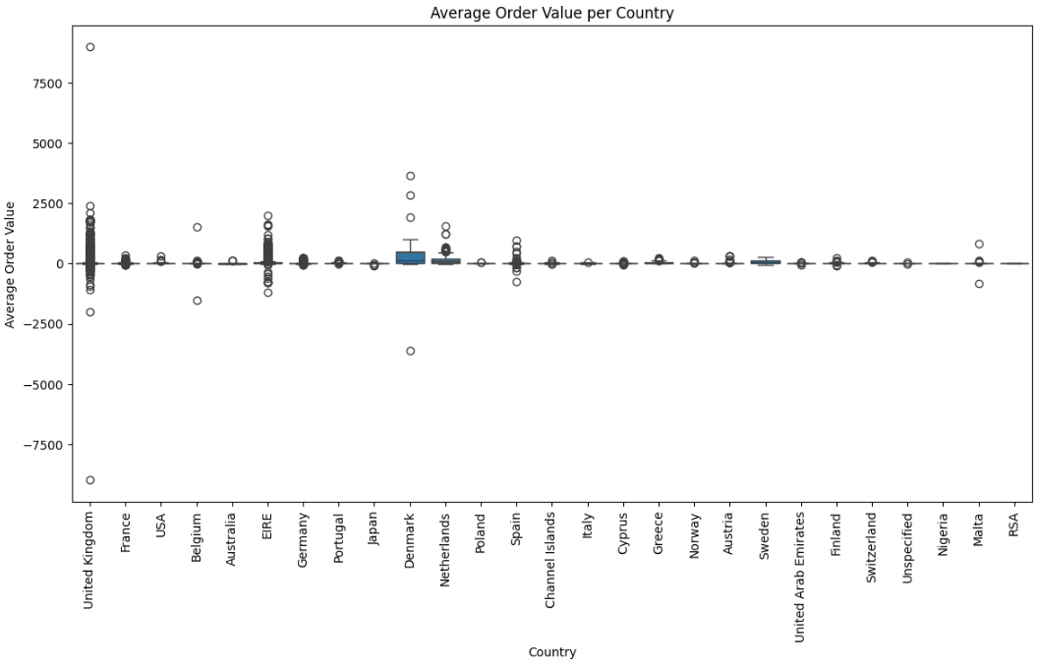
Data Analysis

Slide 11
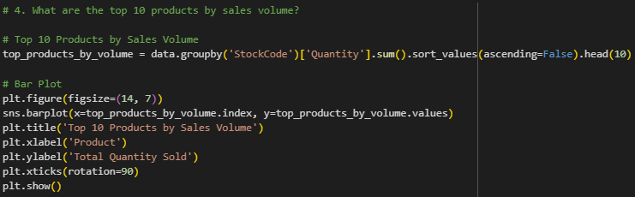
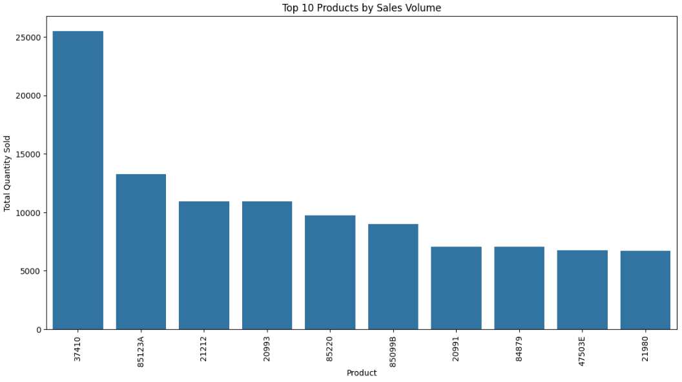
Data Analysis

Slide 12
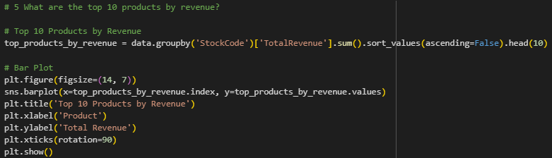
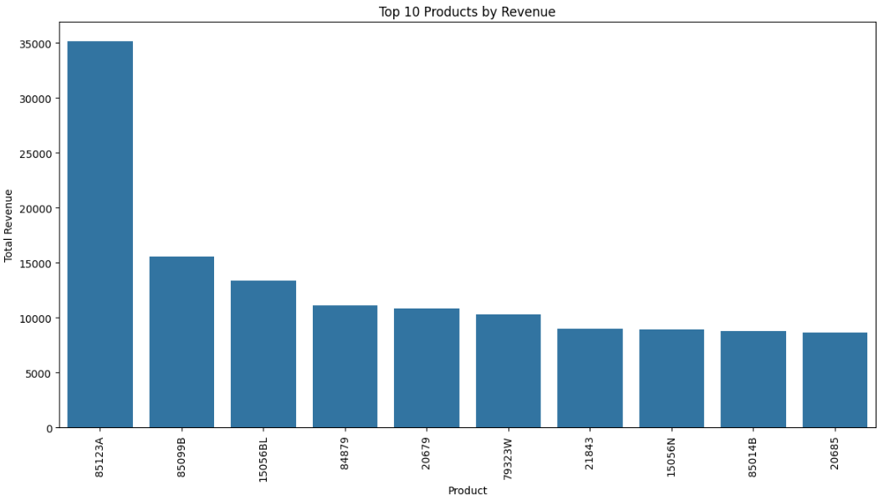
Data Analysis

Slide 13
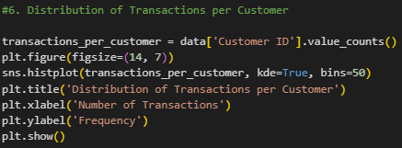
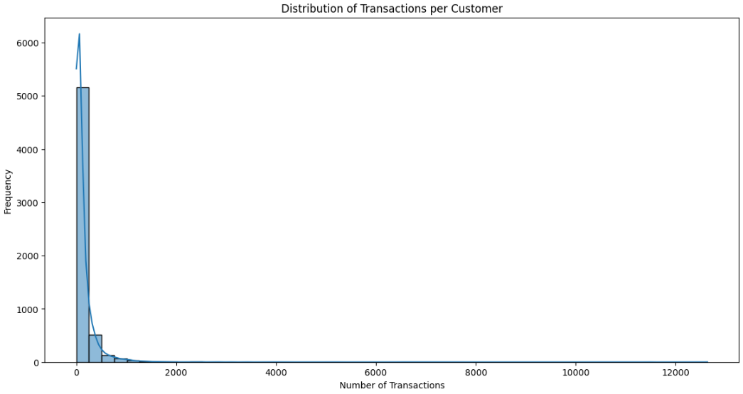
Data Analysis

Slide 14
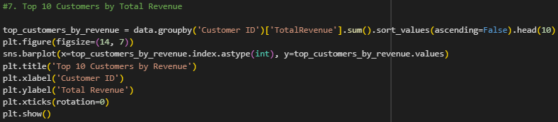
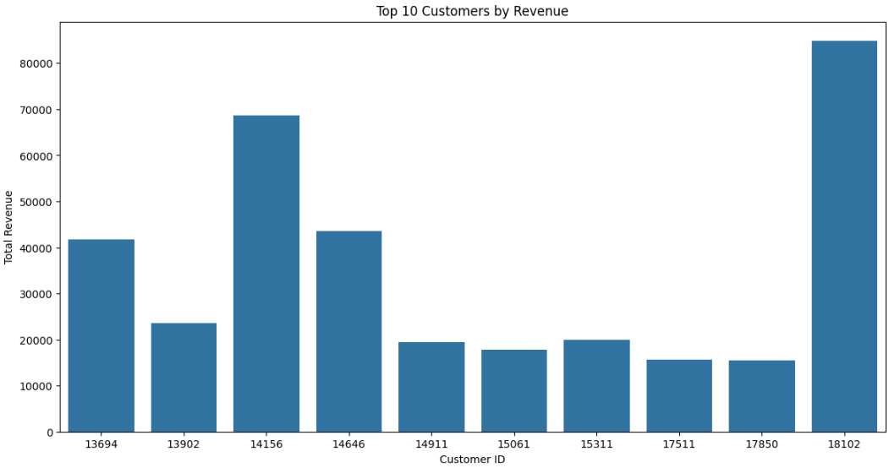
Data Analysis

Slide 15
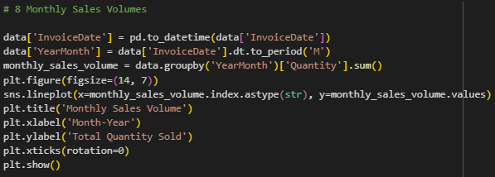
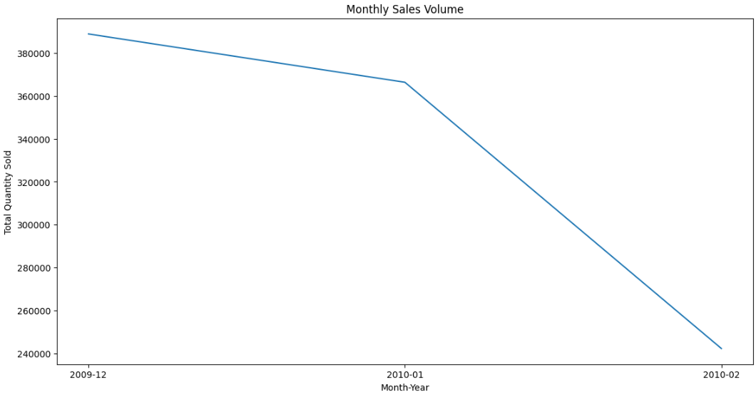
Data Analysis

Slide 16
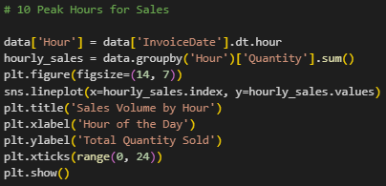
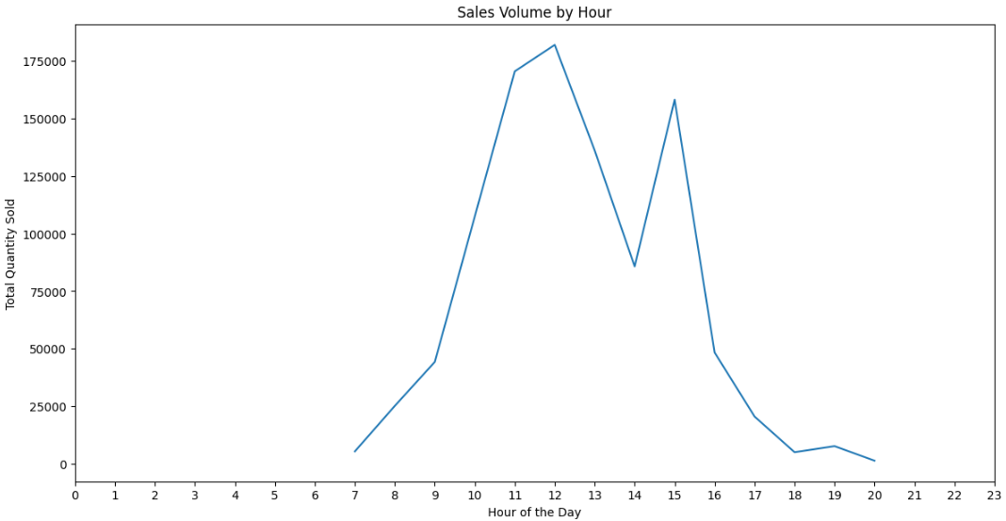
Data Analysis

Slide 17
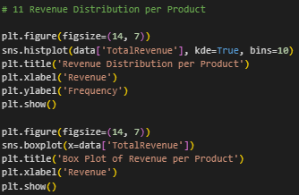
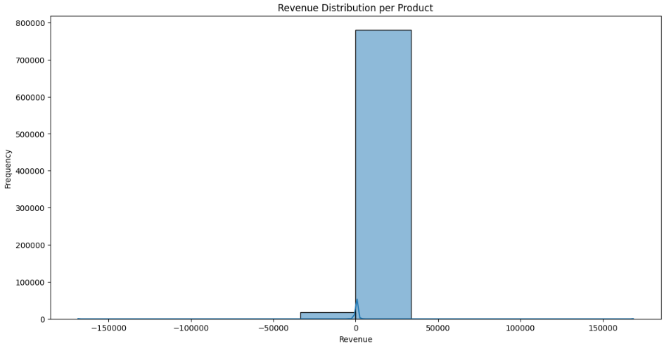
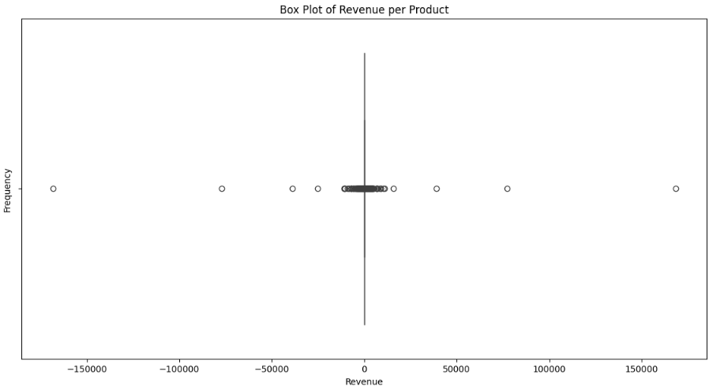
Data Analysis

Slide 18
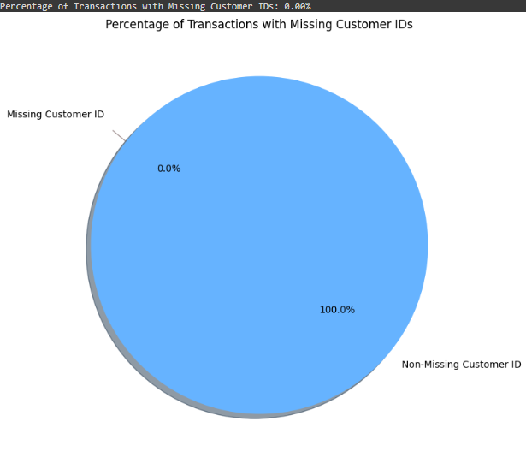
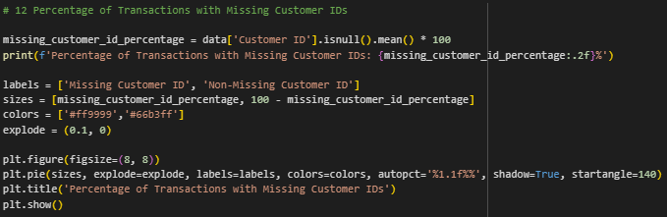
Data Analysis

Slide 19
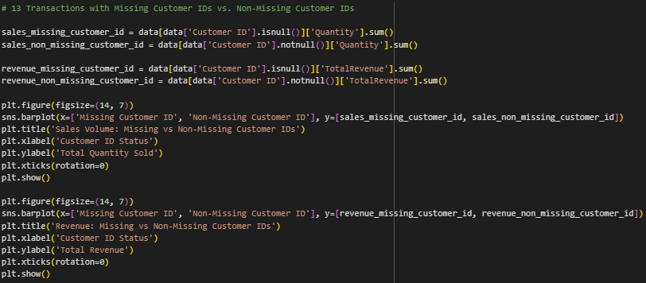
Data Analysis

Slide 20
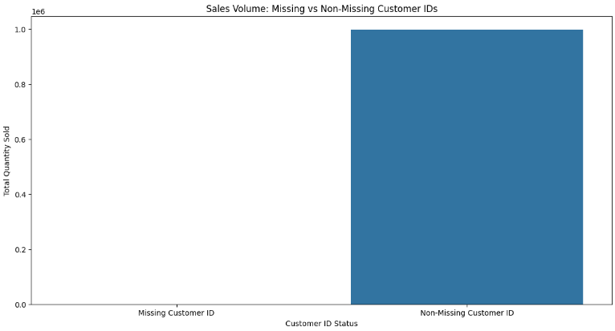
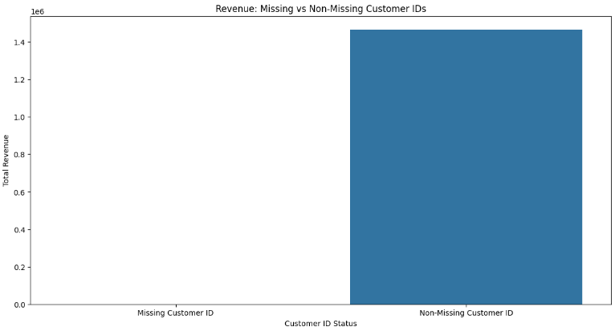
Data Analysis

Slide 21
Key Finders
1- Total Quantity Sold per Country:
2- Total Revenue per Country:
3- Percentage of Transactions with Missing Customer IDs:
i) United Kingdom: 81.5% of the total quantity sold ii) Germany: 6.7% of the total quantity sold
iii) France: 5.1% of the total quantity sold
i) United Kingdom: 83.2% of the total revenue
ii) Germany: 5.9% of the total revenue
iii) France: 4.3% of the total revenue
1) 34.8% of transactions had missing customer IDs

Slide 22
Key Finders
4- Sales Volume: Missing vs. Non-Missing Customer IDs:
5- Revenue: Missing vs. Non-Missing Customer IDs:
6- Price Distribution:
i) Transactions with missing customer IDs accounted for 28.6% of the total sales volume ii) Transactions with non-missing customer IDs accounted for 71.4% of the total sales volume
i) Transactions with missing customer IDs contributed to 26.4% of the total revenue
ii) Transactions with non-missing customer IDs contributed to 73.6% of the total revenue
i) 5% of products had a price above £50
ii) 10% of products had a price below £1.25

Slide 23
Key Finders
7- Distribution of Transactions per Customer:
8- Monthly Sales Volume:
9- Sales Volume by Hour:
i) Top 20% of customers accounted for 80% of the total transactions (Pareto principle)
i) The highest sales volume was observed in November, accounting for 12.3% of the annual sales
ii) The lowest sales volume was in January, accounting for 5.9% of the annual sales
i) The peak sales hour was between 11 AM and 12 PM, contributing to 10.2% of the daily sales volume
ii) The lowest sales hour was between 4 AM and 5 AM, contributing to only 2.1% of the daily sales volume

Slide 24
Thank you!
“By
Aman Gupta”

